Slide 1
OSI MODELS IN COMPUTER NETWORKING

Slide 2
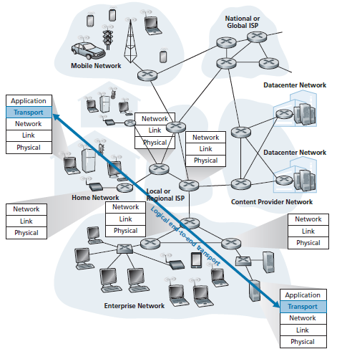
Purpose of osı!
The aim of OSI model is to open communication between different systems without requiring changes to the logic of the existing hardware and software.

Slide 3
Principles of OSI
Each layer should perform a well-defined function
The layer boundries should be chosen to minimize flow across the interfaces

Slide 4
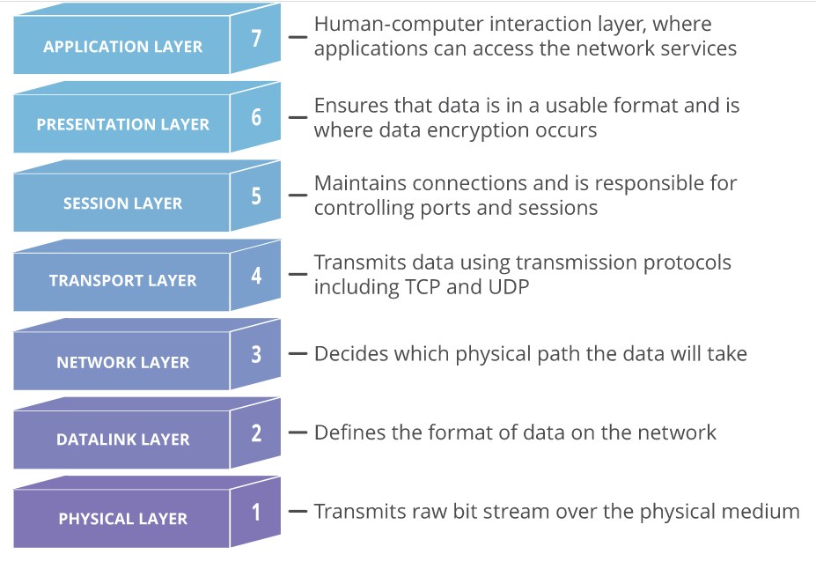

Slide 5
Brief Explanation of OSI Model
The Open Systems Interconnection model (OSI model) is a conceptual model that describes the universal standard of communication functions.^{[1]}
Standardized in 1983 by ISO as OSI 7498^{[2]} and ITU as X.200^{[3]}
OSI model is based on seven encapsulating layers to abstract different task from each other.
7
Application Layer
End-user software, protocols
6
Presentation Layer
Prepare data
5
Session Layer
Create communication channel
4
Transport Layer
Connection establishment Flow control, match connection speed, error control, Split / reassemble packets.
3
Network Layer
Perform best End to End (ETE) path routing.
2
Datalink Layers
Establish / terminate 1 hop connection. Consist of LLC and MAC
1
Physical Layer
Cabled or wireless, electrical characteristics

Slide 6
How does osı model work?
Data flow occurs between layers through Encapsulation & Decapsulation.
When data is passed from application layer and moves downwards till physical layer then this process is called as ‘Encapsulation’.
‘Decapsulation’ is exactly the reverse of this process. Layers cannot be skipped in this process

Slide 7
Seven layer Osı layer modelıng
Application A
Application B
Application Layer
Presentation Layer
Session Layer
Transport Layer
Network Layer
Data Link Layer
Physical Layer
Peer-to-Peer Application Protocol
Application Layer
Presentation Layer
Session Layer
Transport Layer
Network Layer
Data Link Layer
Physical Layer
Peer-to-Peer Presentation Protocol
Peer-to-Peer Session Protocol
Peer-to-Peer Transport Protocol
Network Layer
Data Link Layer
Physical Layer
Network Layer
Data Link Layer
Physical Layer
Communication Network Subnet Roundry

Slide 8
Relationship Between Each Layer
APDU– Application protocol data unit.
PPDU– Presentation protocol data unit.
SPDU– Session protocol data unit.
TPDU– Transport protocol data unit (Segment).
Packet– Network layer host-router protocol.
Frame– Data-link layer host-router protocol.
Bits– Physical layer host-router protocol.

Slide 9
Upper and lower layers
We can also divide these 7 layers into two major groups:
Lower/Media Layers (Layer 1-4) deal with networking. They layers mainly handle data transport issues. These layers are implemented in both hardware and software.
Upper/Host layers (Layer 5-7) are mainly responsible for dealing with applications.

Slide 10
Osı protocols
Every layer of OSI Model has some protocols associated with it. For example, DNS is a protocol which is used for naming of domains and it belongs to application layer. Below are some of the protocols associated with each layer:

Slide 11
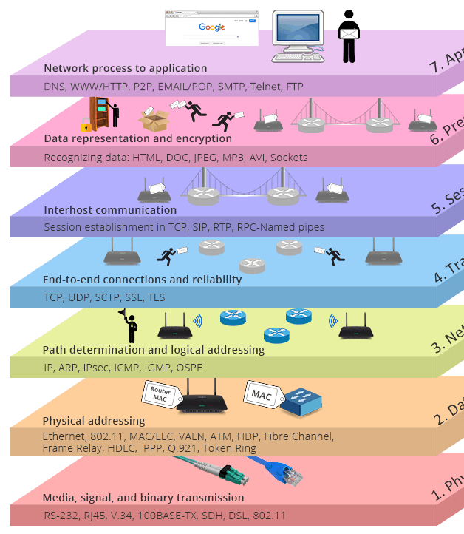
Why is OSI an Important Model?
Although the modern Internet doesn’t strictly follow the OSI Model the OSI Model is still very useful for troubleshooting network problems.

Slide 12
OSI vs TCP/IP
Application layer in TCP/IP model is combined with Presentation and Session Layers.
Datalink and Physical layers are merged and named as Network Access Layer.
Network Layer becomes Internet Layer.
OSI Model
TCP/IP Model
Protocols
7
Application Layer
4
Application Layer
TELNET
DNS
DHCP
6
Presentation Layer
FTP
SMTP
HTTP
5
Session Layer
NFS
SNMP
Others…
4
Transport Layer
3
Transport Layer
TCP
UDP
3
Network Layer
2
Internet Layer
IP
2
Datalink Layer
1
Network Access Layer
ETHERNET
TOKEN RING
1
Physical Layer
FRAME RELAY
ATM

Slide 13
Network equipment at layers
Firewalls
Gateways
Load Balancers
Computers

Slide 14
Peer to peer process
Within a single device, each layer uses
The services provided by the layer just below it
Provides services for the layer just abouve it
Communication is made possible by using the peer to peer protocols approriate to that layer X.
Physical layer 1 communication is direct device A sends a bit stream to machine B
Header is the control data appended to the beginning of the data. Header are added at layers 2,3,4,5 and 6.
Trailer is the control data appended to the beginning of the data. Trailer is added at layer 2.
Layer 2 removes the data meant for it then passes the rest to layer 3
Layer 3 removes the data meant for it then passes the rest to layer 4 and so on like this…

